Slide 1
Field Experience
Kelsey Haggerty
ITL528: Integrated Design II
February 3, 2018

Slide 2
One Day Lesson Plan
Lesson Plan Info:
  Subject: Life Science
  Grade Level: Middle School
  Unit: Cell Biology
  Content: Cell Organelle Vocabulary
Class Info:
  Afterschool Program
  Sixth Graders
  3 boys and 4 girls
  Racially, socioeconomically diverse

Slide 3
Lesson Plan Details
Teacher: Kelsey Haggerty Subject: Life Science Lesson Title: Getting to Know the Cell
Classroom Details Time: 1 hour Equipment: Computer/screen, handouts, chromebooks (optional), white boards Resources: Video: https://youtu.be/URUJD5NEXC8 | Content Details Grade: 7 Standard(s): MS-LS1-2. Develop and use a model to describe the function of a cell as a whole and ways parts of cells contribute to the function Objective: Students will begin to recognize and define cell organelle vocabulary

Slide 4
Lesson Plan Details (continued)
Time in mins. | Lesson Element | What is the teacher doing? | What are the students doing? | Notes / Tips
5 mins | Student Friendly Objective | Tell students: By the end of the lesson you should be able to… Recognize and define specific vocabulary terms related to cell biology/organelles | -Settling in -Taking out materials (notebooks, chromebooks, writing utensils, etc.)
10 mins | Link to prior knowledge (pre-assessment) | -Quick verbal review of what the definition of a cell is and the various types. (video will also review this information) -Pass out handouts | -Listening -Responding to questions -Taking notes as needed | Handout attached
10-15 mins | Input / Modeling | -Show a video of a tour of cell. | -Paying attention to video

Slide 5
Lesson Plan Details (continued)
Concurrent with video | Guided Practice (checking for understanding) | -Teacher will pause video as needed to interject, give emphasis or answer questions | -Filling in the definitions and/or function of each part of the cell according to the video
3 mins | Transition | -Stop video -Separate students into partners or small groups | -Getting in their groups
15 mins | Independent Practice (ongoing assessment) | -Instruct students to go over the definitions together, using the video, textbook and each other as resources | -Following the instructions to finish filling in handout
3 mins | Transition | -Instruct students to clean up materials | -Clean up materials
10-15 mins | Closure (post-assessment) | -Full-Class quiz game, using personal white boards to answer questions about the days vocabulary -Give students the link to the video and other resources to review on their own time | -Answer vocabulary questions on personal white boards

Slide 6
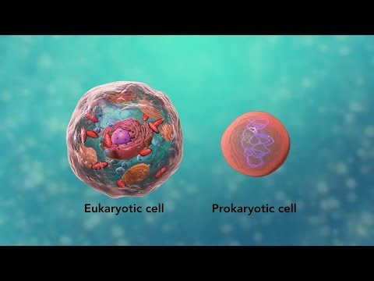
Resources
Video:
https://youtu.be/URUJD5NEXC8

Slide 7
Resources (continued)
Handout Content:
  Vocabulary
    Cell Membrane
    Organelle
    Nucleus
    DNA
    Ribosomes
    Cytoplasm
    Endoplasmic Reticulum (ER)
    Golgi Apparatus (or Body)
    Vacuole
    Mitochondria
    Cytoskeleton
    Chloroplast
    Cell Wall
    Cilia
    Flagella

Slide 8
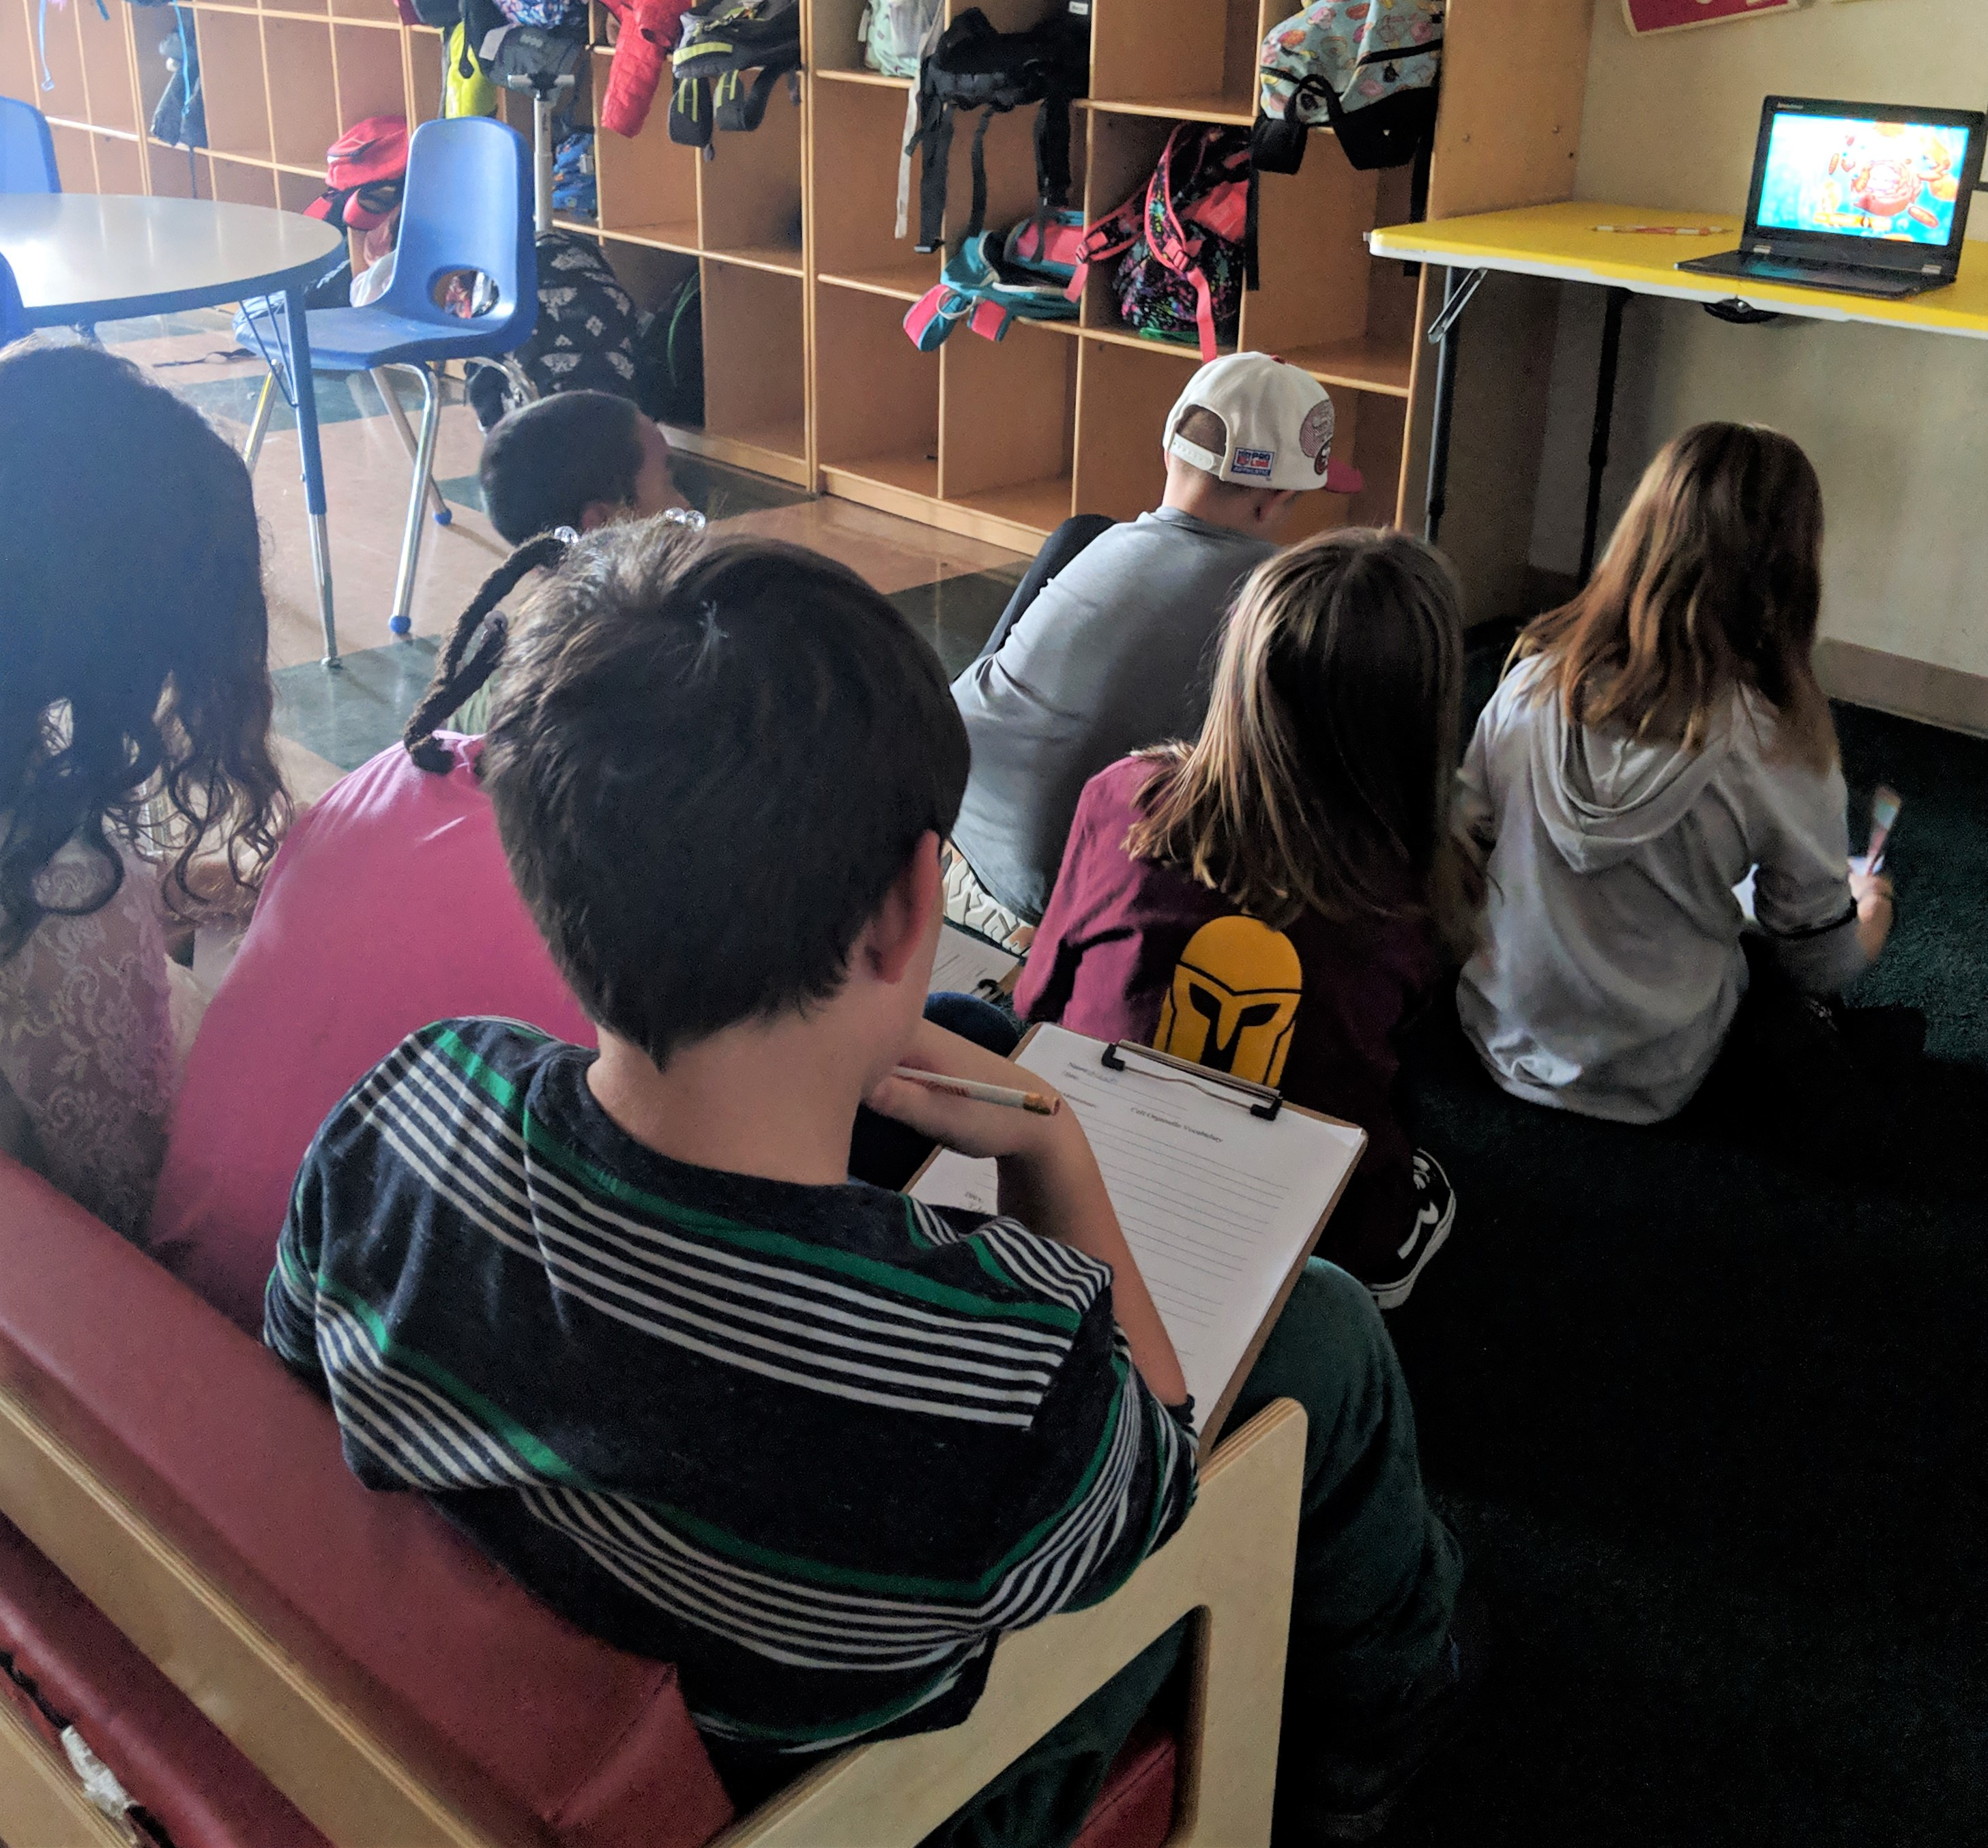
Lesson in the Field
I taught my lesson to a small group of sixth graders in an afterschool program in Rancho Cordova, CA
They were a grade younger than my target and hadn’t had any previous exposure to the material
They each received a handout and were asked to take notes on the vocabulary introduced in the video
They loved the video format
Students watching video and taking notes

Slide 9
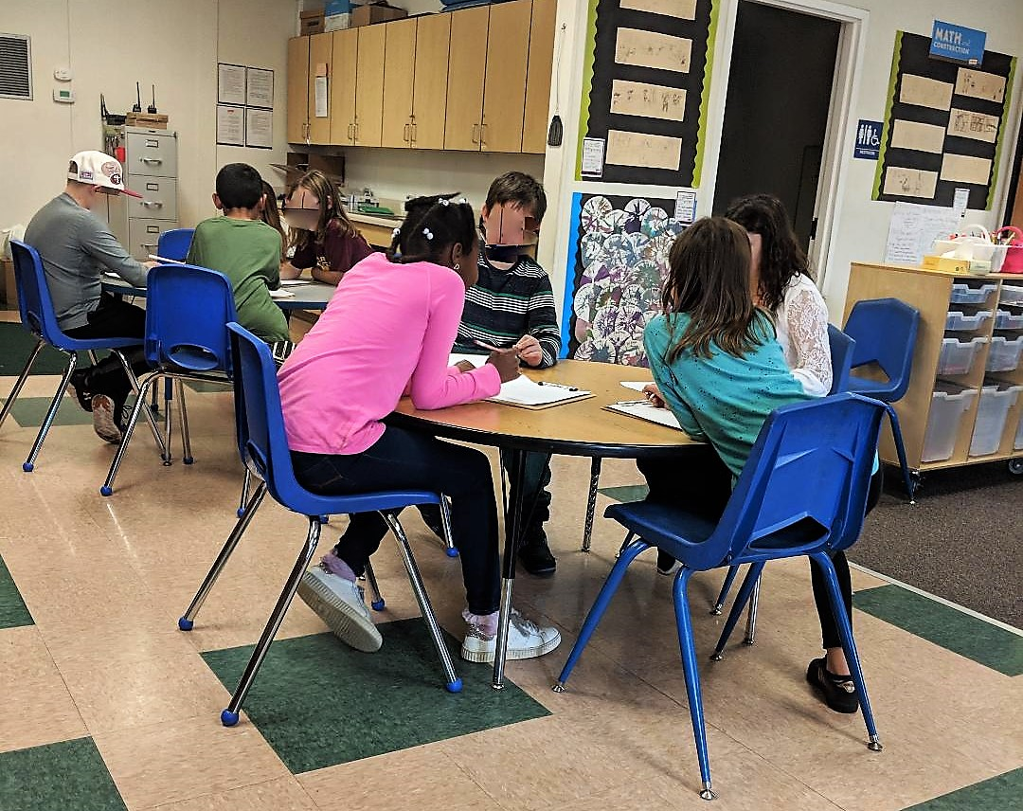
Group Work
Students then worked in groups
Despite the material being brand new to them, they still seemed to be engaged and absorbed the material
They shared notes and discussed the video
(Faces have been blurred for student privacy)

Slide 10
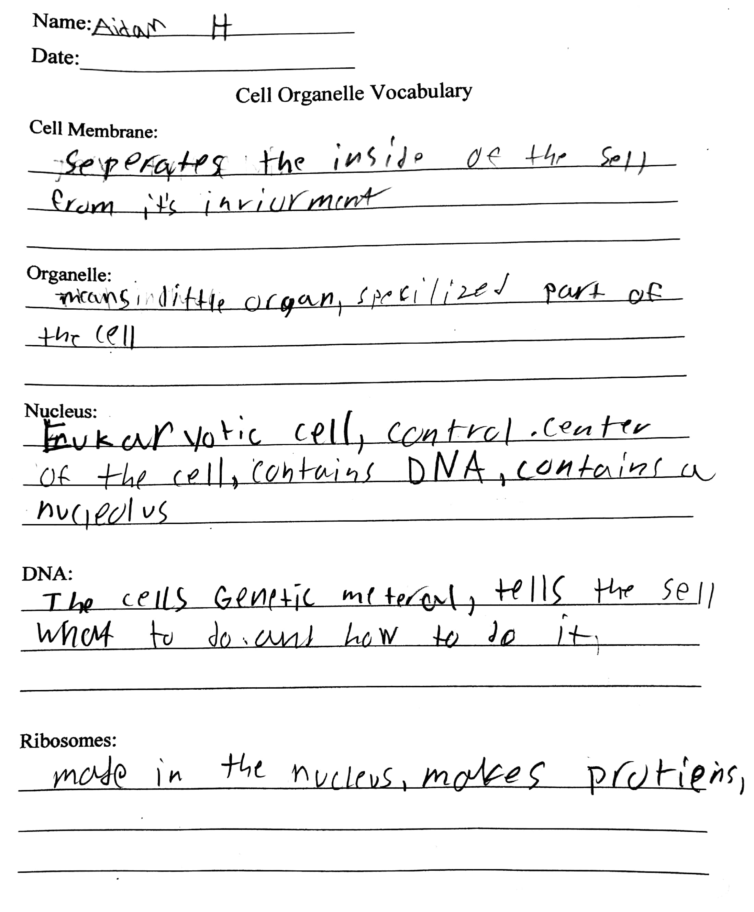
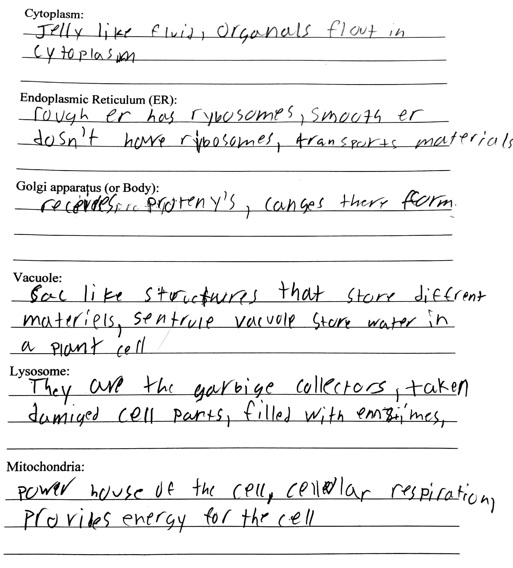
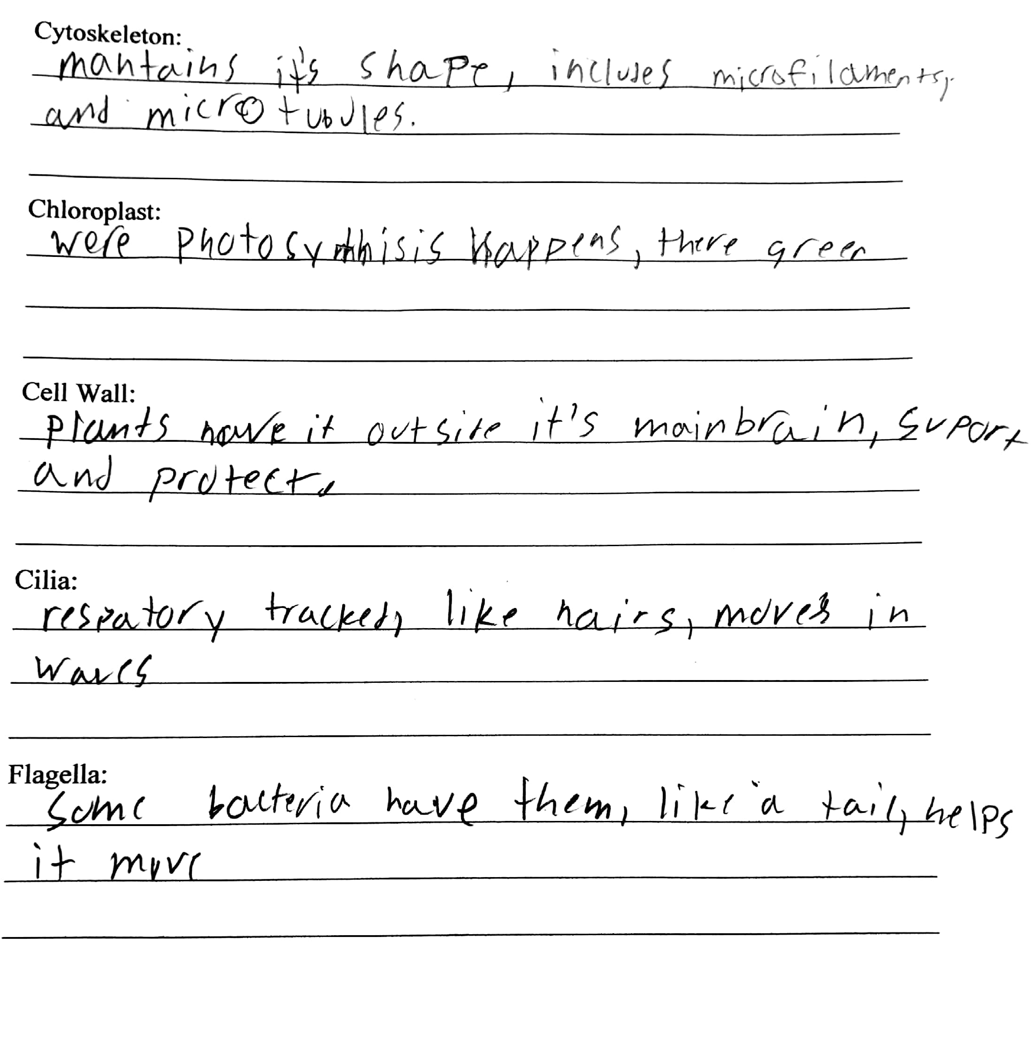
Sample Notes

Slide 11
Conclusion
The lesson was very successful
It gave me great experiences integrating:
  media and technology
  collaborative group work
  introductions to new material
I am beginning to feel more confident in my ability to create and implement effective lesson plans

